Slide 1
A Digital Examination – or How Covid-19 has Changed the Way We Work
David Melia
Director of Nursing and Quality/Deputy Chief Executive
The Mid Yorkshire Hospitals NHS Trust

Slide 2





Slide 3

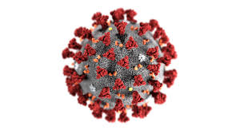

Slide 4





Why me?

Slide 5



Slide 6
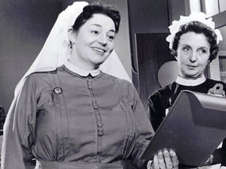
What do I know?

Slide 7



Slide 8
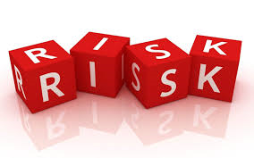
At what cost did we change?

Slide 9
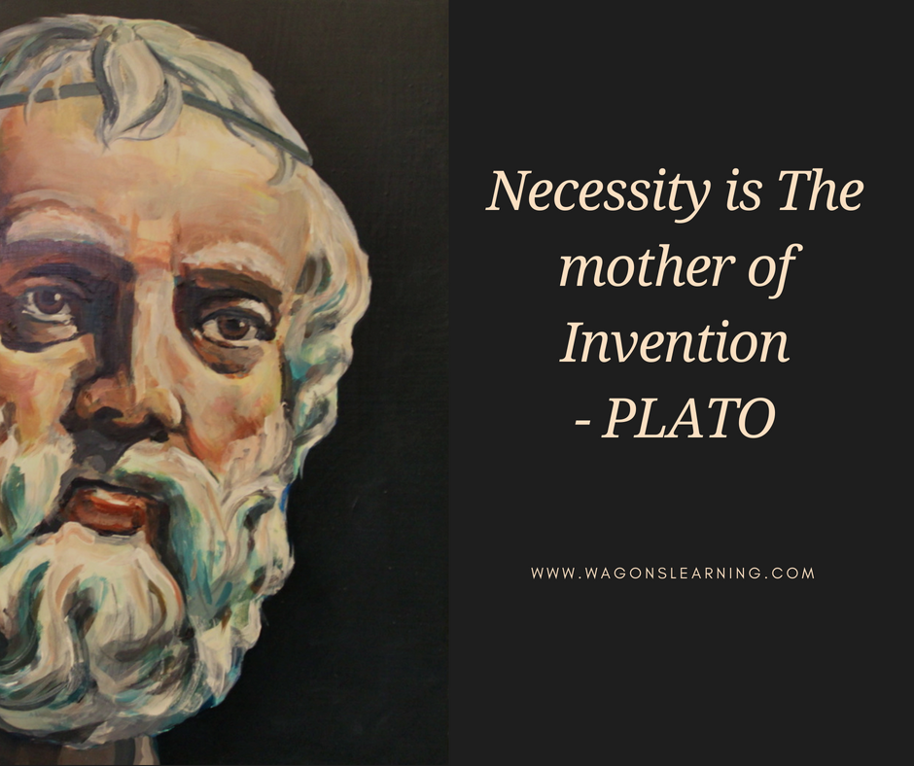
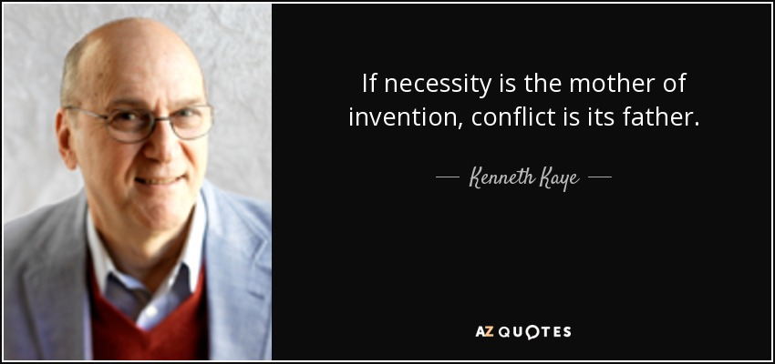

Slide 10
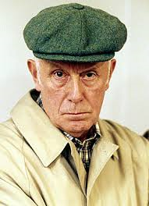
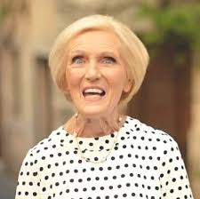
Moving on……

Slide 11


