Slide 1
Professor Liz Breen
Professor of Health Service Operations
Director of the Digital Health Zone
University of Bradford
“A City Perspective, aligning the Stars”

Slide 2
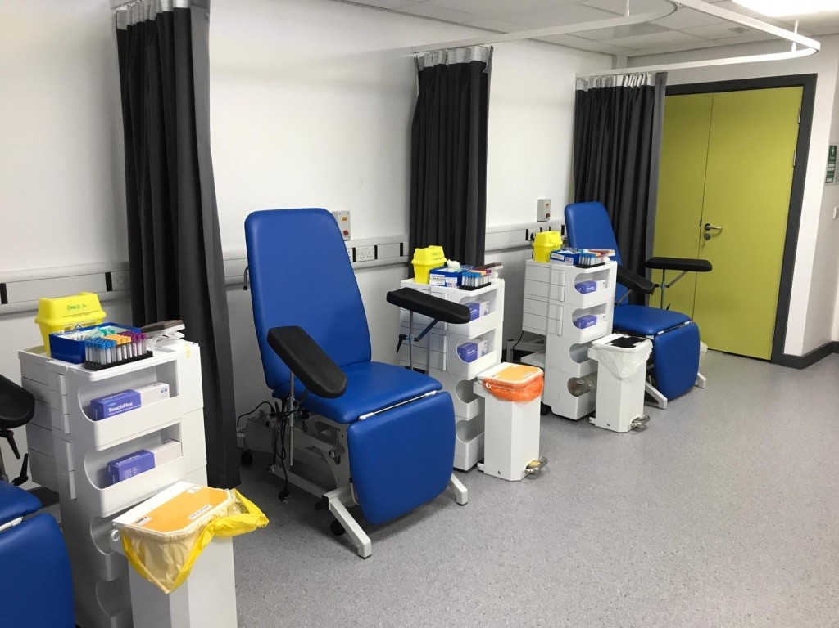
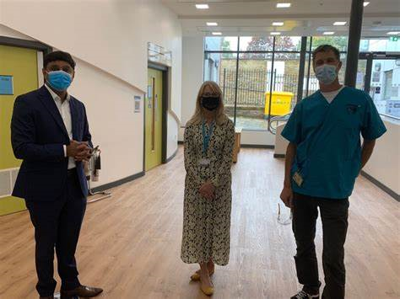
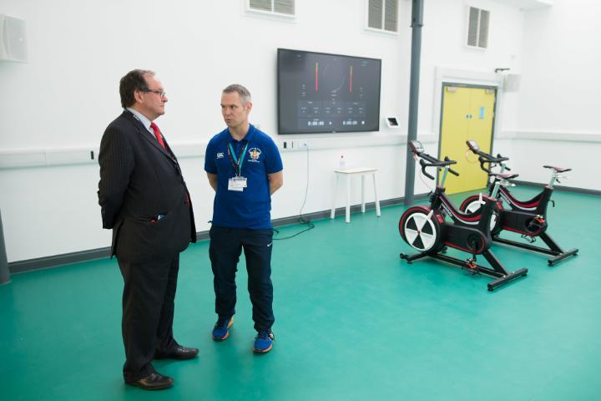
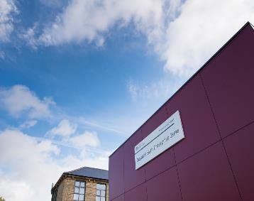

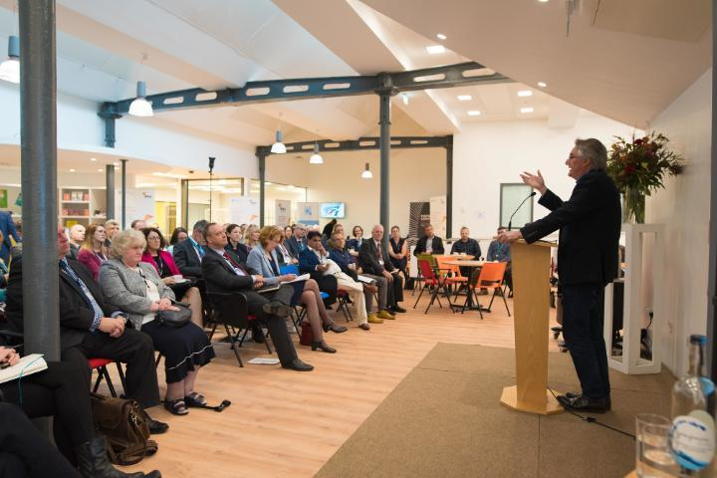
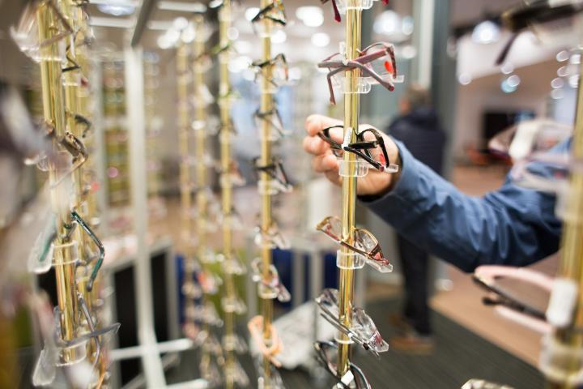
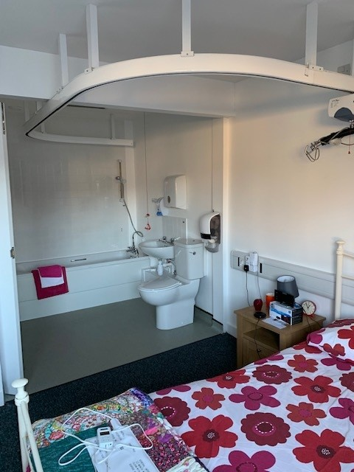
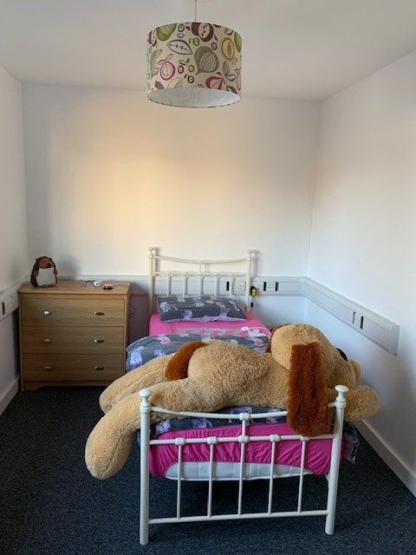
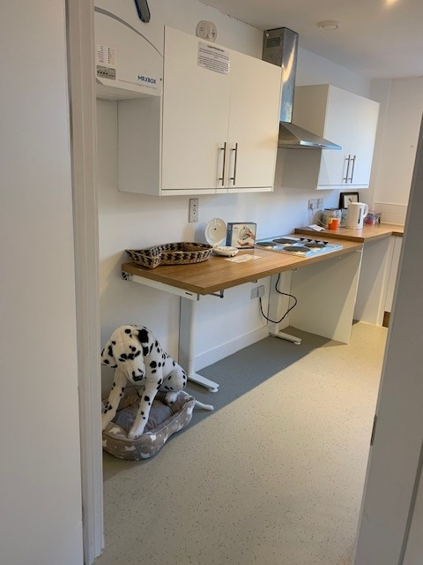
Notes:
The Digital Health Enterprise Zone is a £13m partnership between the University of Bradford and
Bradford Council to encourage greater interaction between the University and business to increase
regional innovation and growth. DHEZ's purpose-designed Phoenix Southwest Building on the
University of Bradford City Campus is our home. The Phoenix Building houses four floors of research,
learning, business incubation and public clinics. It features a full-size two-bedroom Technology
House and Living Laboratory. The building functions as a hub of digital health knowledge and
innovation, and a space for research projects to develop.
A unique feature of the DHEZ hub in our region is the versatility of our public facing spaces and
training in simulated environments. The hub is open to the public to visit the Eye Clinic to access a
broad range of optometric and specialist clinics; the physiotherapy and sport clinic, offering
musculoskeletal, neurological and sports rehabilitation, in addition to various Health, Wellbeing and
Performance services, or medication reviewed by trained pharmacists. Our clinical spaces are used
for trails and evaluation, recently hosting the Novavax COVID-19 vaccine trail. The simulated
environment in our Technology House provides a real-world immersive experience that, for
example, has been used to train paramedics, provide life support training for the public, and explore
the use of technology in adult social care.

Slide 3

As astronomy lesson……
Bradford and The Halo effect
Written in the stars
Star gazing in Bradford
Video killed muted the radio star
Everybody is a star
Reach for the stars
Aligning the stars for the future
Catch a falling star
A thousand stars

Slide 4
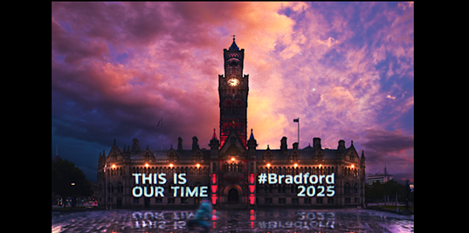
Bradford and the halo effect
Awarding of the City of Culture 2025 bid – impact on our community?
Excellent research/activity being undertaken – Act as One, Research as One, University of Bradford.
Passionate people in health and social care
Our Time Is Now
Notes:
The halo effect is the tendency for positive impressions of a person, company, brand or product in one area to positively influence one's opinion or feelings in other areas.

Slide 5

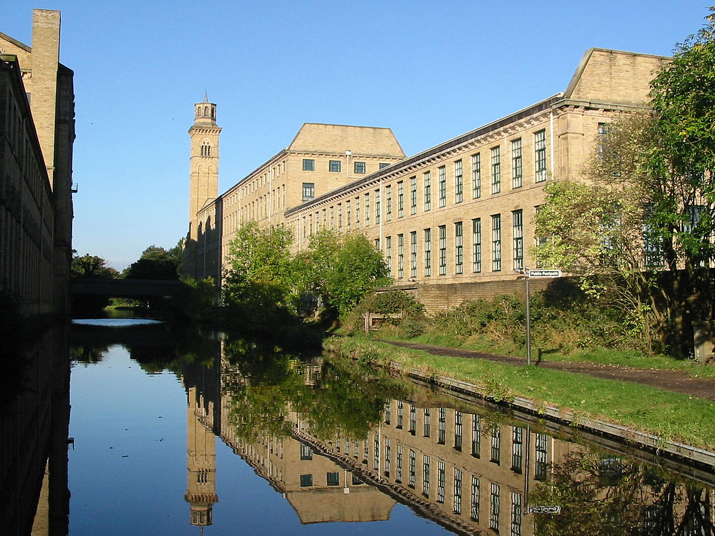
Bradford – rich, diverse and complex
Bradford is the 5th largest metropolitan authority in England with a growing population of 542,100.
26.3% of the population are aged under 18 compared with 21.4% nationally making Bradford the youngest city in the UK.
Bradford has a diverse population with ethnic minorities making up 36% of the total population. There are 160 languages spoken by children attending schools in the district.
Impact on health and social care provision and inequalities is challenging.
Notes:
https://www.bradford.gov.uk/business/bradford-economy/about-bradfords-economy/#:~:text=Population%201%20Bradford%20is%20the%205th%20largest%20metropolitan,spoken%20by%20children%20attending%20schools%20in%20the%20district.

Slide 6

Written in the stars
Notes:
What are our constellations/structures within the digital space and within our NHS institutions? Can we interpret them? I can’t see these types of configurations in the sky – is that just me, is it the configurations, or is it the environmental conditions – or a bit of them all?
Is this an analogy of NHS management and digital?

Slide 7



Written in the stars
What/who are the stars in the digital space in Bradford place?
How do we support and nurture these?
Are they aligned, connected, purposeful?
Are we ready to alter our destiny and reconfigure our constellations (adhoc or permanently)?
Notes:
Big dipper, Ursa Major – greater bear.
Ursa Minor – small bear
Again the constellations are there but I can’t see these – others can, so it really must be me! But science says they are there so I trust the science. Are we saying the same about the trust/faith in our system, strategy/leaders?
Football example? Playing different position based on need at the time to have a strategic impact – not essentially as the winning element but as a psychological and operational advantage or deterrent. Are we thinking about our workforce in this manner?

Slide 8
Star gazing in the Bradford health and social care community
Act as One
Technology
Community
People
Systems
Technology
Systems
Act as One
Community
People

Slide 9


Video killed muted the radio star
What mutes our stars?
Recruit
Grow
Retain
Inspire
Get out of their way
Set goals
Don’t crucify mistakes
Say thank you
Give constructive feedback
Update on business performance
Share success
Avoid overworking
Sense of purpose
People
Notes:
People should be our optimal focus – they underpin system design and delivery, design and use of technology and are part of and support our Bradford community.
Getting staff, motivating them, nurturing them, retaining them.
What mutes our stars? Environmental influences – internal and external. Bureaucracy, salary, job insecurity, lack of promotion opps, lack of recognition.
Motivating staff?
1. Inspire them. 2. Get out of their way. 3. Set them goals. 4. Don’t crucify mistakes. 5. Say thankyou. 6. Give them constructive feedback. 7. Update them on business performance. 8.Give them a share in success. 9. Avoid overworking them. 10. Give them a sense of purpose.

Slide 10
Everybody is a star
In an era of shifting sands with staff movement out of roles, backfilling, secondments etc it is easy to lose sight of the great staff you have.
As leaders:
  be aware of your impact
  focus on potential and possibility
  make it okay to leave
  give your employees the respect and attention they deserve
  re-recruit them
  (Cohen & Roeske-Zummer, Harvard Business Review, 2021)
Notes:
https://hbr.org/2021/10/with-so-many-people-quitting-dont-overlook-those-who-stay

Slide 11
Reach for the stars
Quality Circles - manufacturing
What are you aiming for?
Idea management – seeking raw concepts and notions and converting these into actionable ideas
Creating an idea management system- post ideas, get votes, deliver or respond to feedback, and develop the ideas into innovations that make a difference to the company (HBR, 2017).
Ideation rate = number of ideas approved by management/but the total number of active users in the system.
Increased Ideation
Diversity in contribution
More people
Frequency
More ideas
Evaluation more people involved
Notes:
Https://hbr.org/2017/10/data-from-3-5-million-employees-shows-how-innovation-really-works
One large industrial manufacturer has put an innovation management system to good use. The company has mastered frequency and scale: it has run 15 challenges in the last year with over 2,000 active participants. Hundreds of ideas have poured in, generating thousands of comments. In 12 months, the company selected over 50 ideas to implement.
For example, the company challenged its employees to find ways to serve customers better. Among the problems that surfaced was the difficulty of inspecting a particular aircraft part overnight. The inspection process typically took eight hours. The company’s customers – airlines – found this frustrating because sometimes planes land late and need to take off early.
As the service techs understood, the problem wasn’t actually the inspection. It was the process of threading the camera inside the aircraft part to inspect it. That took seven hours. The subsequent inspection took one.
An administrative assistant at the company who was familiar with the airlines’ complaints responded to the challenge. She had recently seen the Tom Cruise movie Minority Report. She posted an idea, wondering, “Why can’t we send a robotic spider into the part, like the ones in the movie?”
While a lot of people reviewing her suggestion found it silly, the company’s Chief Technology Officer was intrigued. He tried putting a miniature camera on a remote control set of robotic legs and walking it into the part. It worked. He then turned the secretary’s idea into a standard practice. Now the inspections takes 15% as much time as they used to, and the airlines are a lot happier

Slide 12

Aligning the stars for the future
Whilst national policy exists which offers guidance as to workforce composition and development, this does not fully reflect local needs. Bradford and Craven must design tailored approaches to workforce recruitment, training and management which reflect the uniqueness of the Place.
The increasing reliance on digital solutions in the development of health and care services has seen a rapid expansion for the demand for both specialist and general data and digital skills throughout the workforce
  We can better connect the local workforce planning and information.
  Any current educational response needs to be innovative, flexible, and adaptable to meet future needs.
  The need for digital and data skills is an important part of this context.
Notes:
Drawing on outputs of Ethical Healthcare Consultancy project commissioned by BDC HCP

Slide 13

How do we secure a sustainable and vibrant digital and data skills environment?
How do we create a long-term pipeline of local inclusive talent in digital and data?
How to develop a centre of digital and data excellence with key local partners to assist in delivering this ambition?
How can partners support the proposed virtual Health and Care digital and data skills pipeline solution?

Slide 14
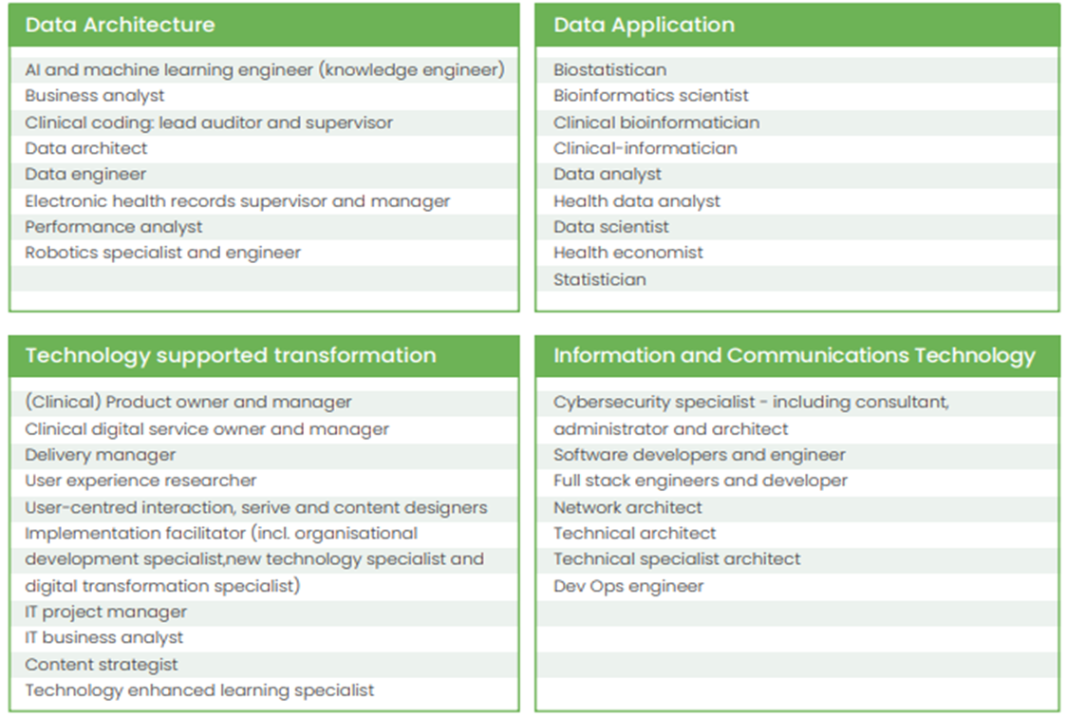
New, emerging, in-demand and crucial roles over the next 10 years (NHSX, 2021)

Slide 15
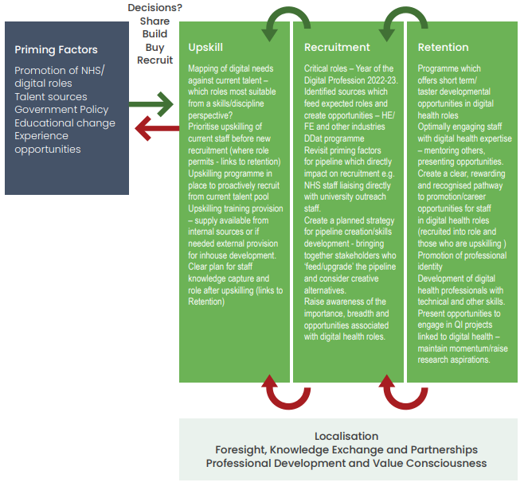
The Place: digital health landscape

Slide 16
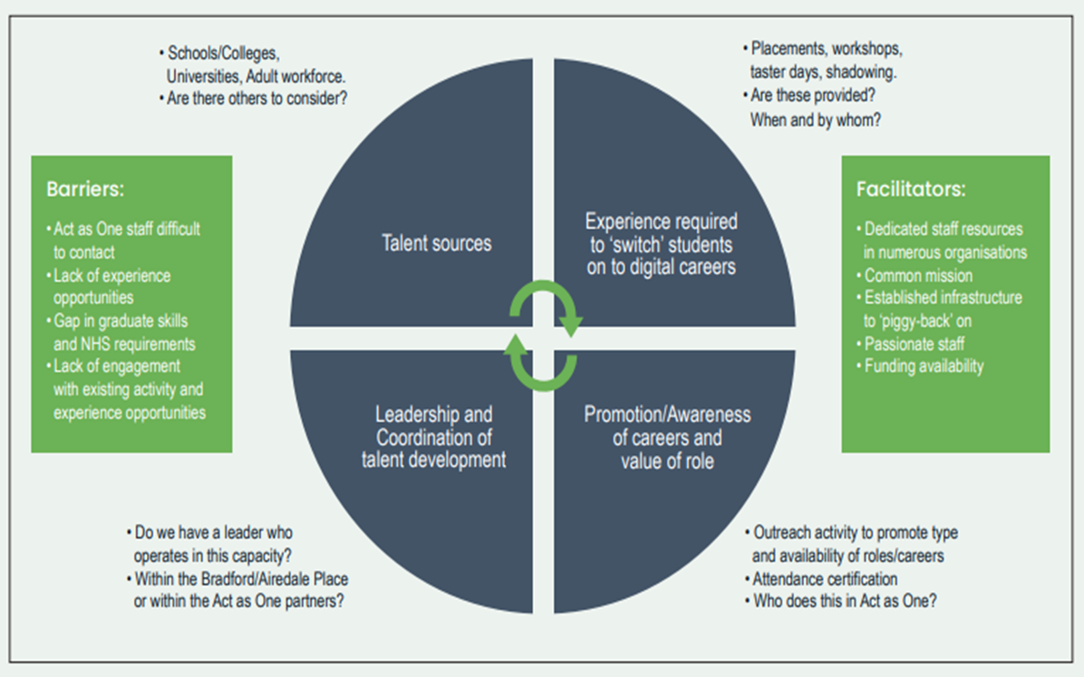
Act as One digital pipeline development

Slide 17
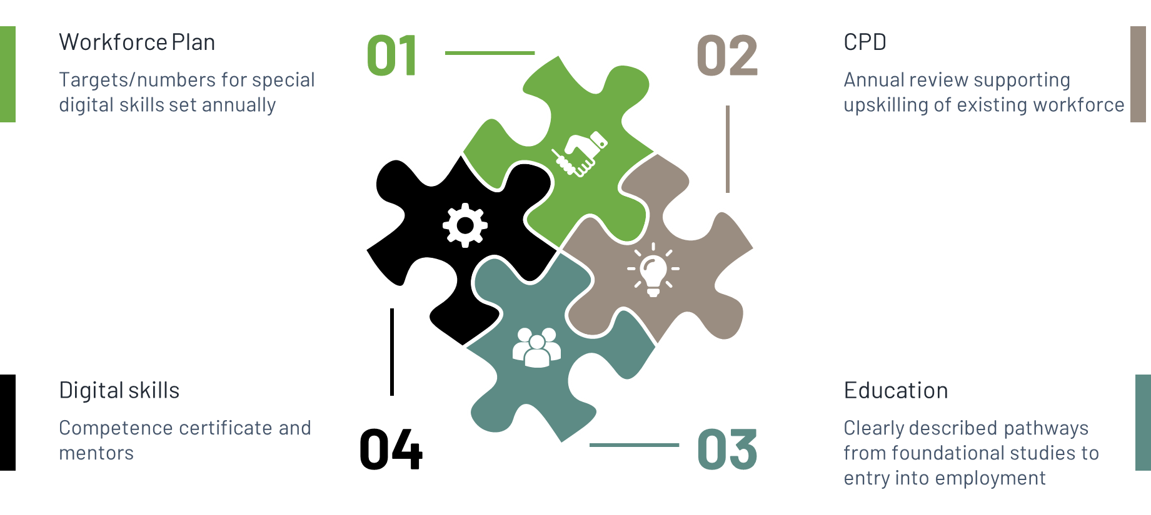
Outcomes of the digital and data skills pipeline project include……

Slide 18
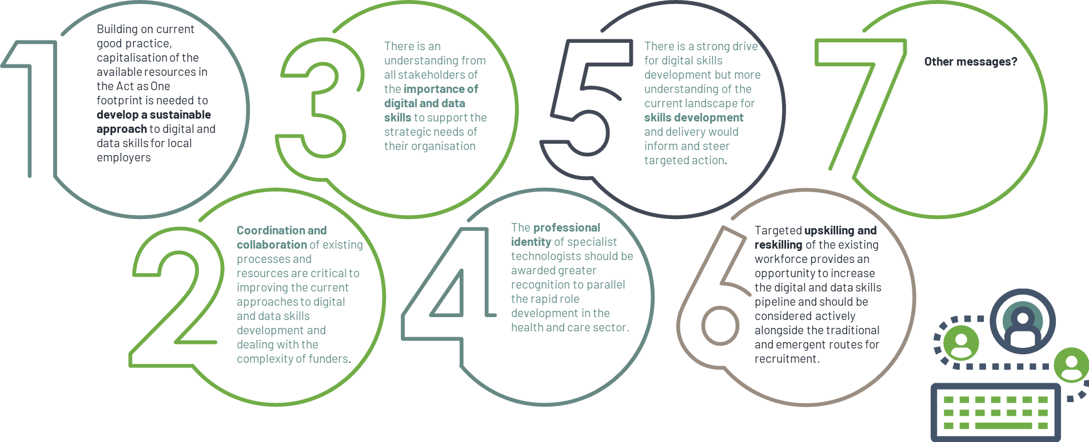
Main messages

Slide 19
Catch a falling star
What are those opportunities to instigate change in our digital space that are not actioned?
Why does this happen and where do we keep these?
How can we harness these for wider group use across West Yorkshire?
What resources do we have to follow these up and how can a partnership approach make this happen?
#GroupPower
Notes:
Catch a falling star and put it in your pocket
Never let it fade away
Catch a falling star and put it in your pocket
Save it for a rainy day

Slide 20
A thousand stars.……
Our digital and data workforce are shining stars in Bradford
We need to provide the right roles and the best environments for them to shine and recognise talent
Digitisation of our operational processes is important for efficiency and effectiveness – all staff need to have the confidence and skills to engage with these.
Our leaders need to be resilient, tough and vulnerable, configure our constellations, and be prepared to recalibrate.
Staff are our ideation factory – welcome their ideas!
There is no I in team and in the Digital Space we are all about #TeamWork
Notes:
https://hbr.org/2020/10/todays-leaders-need-vulnerability-not-bravado?utm_medium=social&utm_source=linkedinnewsletter&tpcc=linkedinnewsletter

Slide 21
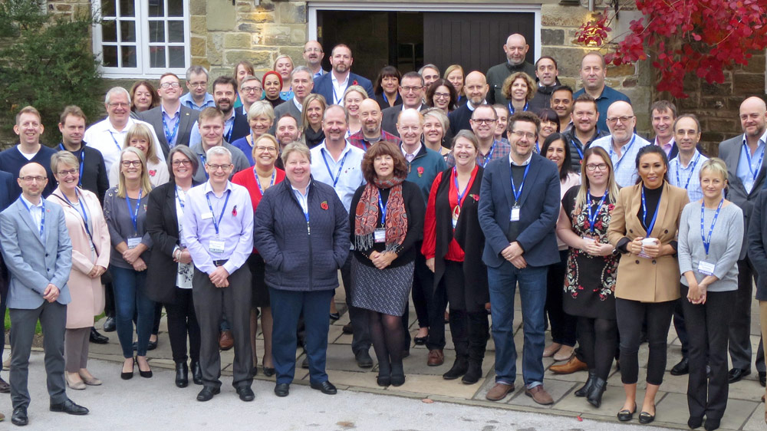

You are the stars, current and future!
You are amazing, keep being you.
Your communities thank you.
I thank you.

