Slide 1
Dr Richard Cullen CCIO and innovation lead SYICB

Slide 2
HEALTH INEQUALITIES DIGITAL INCLUSION

Slide 3
National
data on
digital
3.8
million (7%) people in the UK remain completely offline
infrastructure
An estimated 9 million people
(16%)
are unable to use the Internet or their
& skills
device without assistance
Circa 2.7 million (5%) people can access the internet but lack the ability to
Presented is a
summary of
use it to its full advantage
key stats from the latest
Lloyds Consumer Index 2020
In total, an estimated 11.7 million (22%) people in the UK are without the
digital skills needed for everyday life
Two
-
thirds (66%) of those online have not used the internet or digital
apps
and tools to manage their health
Only 15.7 million people have the Essential Digital Skills needed for
work
Two
-
thirds of jobs need digital skills of some kind, and yet 5.2% of the UK
workforce are not fully digitally enabled

Slide 4
National data
96
% of households in Great Britain have internet access
•
, up from 93% in 2019 and
on internet
57
% in 2006 when comparable records began.
usage
•
87
% of all adults shopped online within the last 12 months
, up from 53% in 2008; those
aged 65 years and over had the highest growth, rising from 16% to 65% over this
Presented is a snapshot of
period.
ONS data taken from
January to February 2020
49
% of adults in Great Britain aged 25 to 34 years used a virtual assistant smart
•
speaker or app
, compared with 17% of those aged 65 years and over; 35% of all
adults used these “internet of things” devices.
•
18
% of adults in Great Britain used internet connected energy or lighting controls
with those aged 35 to 44 years using these most at 26%.
•
Internet connections in households with one adult aged 65 years and over have
increased by seven percentage points
since 2019 to
80
%
; these households still had
the lowest proportion of internet.
•
76
% of adults in Great Britain used internet banking
, increasing from 30% in 2007 and
73
% in
2019.

Slide 5
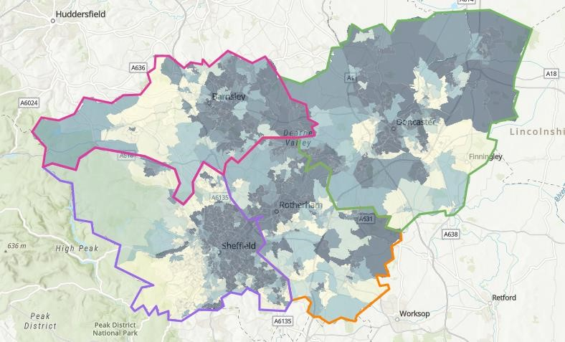
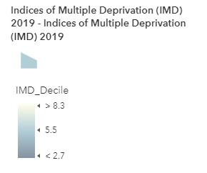
Deprivation:
IMD overall
decile
This map combines information
from seven domains to
produce an overall relative
measure of deprivation.
The domains are combined
using the following weights:
Income Deprivation (22.5%),
Employment Deprivation
(22.5%)
, Education, Skills and
Training Deprivation (13.5%),
Health Deprivation and
Disability (13.5%), Crime (9.3%),
Barriers to Housing and
Services (9.3%), Living
Environment Deprivation
(9.3%).

Slide 6
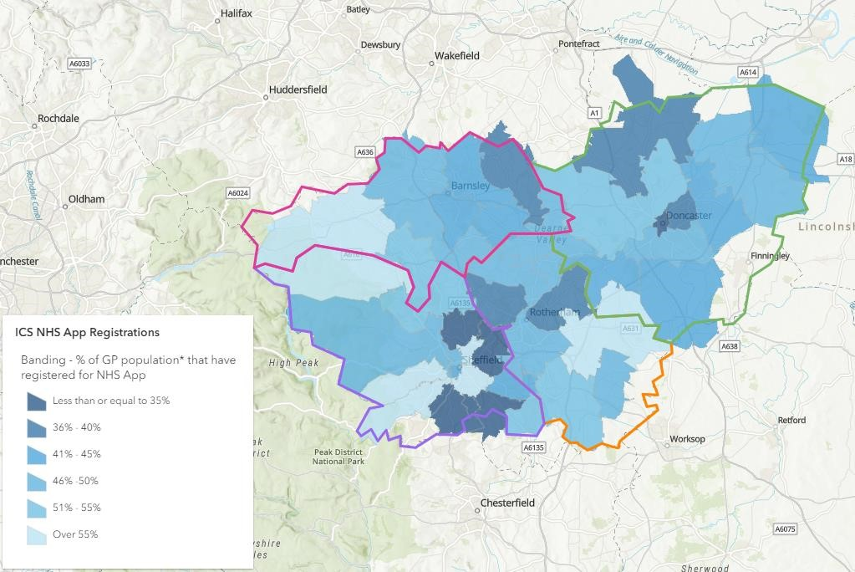
% of GP
population that
have registered
for the NHS App
•
This map shows percentage of
the GP population aged 13+
registered for the NHS App
across the ICB, grouped by
postcode
district (this means
that some parts of the ward
boundary are not shaded)
•
Sheffield has the highest
percentage of their GP
population aged 13+ registered
for the NHS App (46.09 %)
•
Doncaster has the lowest
percentage of their GP
population aged 13+ registered
% of GP population
for the NHS App (43.50 %)
PLACE
NHS App registrations
GP registered population
aged 13+ registered for
Difference from National
aged 13+ years
NHS App
Target (75%)
•
All Places require significant
growth to reach the 75%
118,542
272,493
43.50
%
31.50
Doncaster
%
national target
98,144
219,465
43.63
%
31.37
Barnsley
%
102,860
224,774
45.76
%
29.24
Rotherham
%
22
Dark colours = lower % of GP
242,339
525,772
46.09
%
28.91
population registered
Sheffield
%

Slide 7
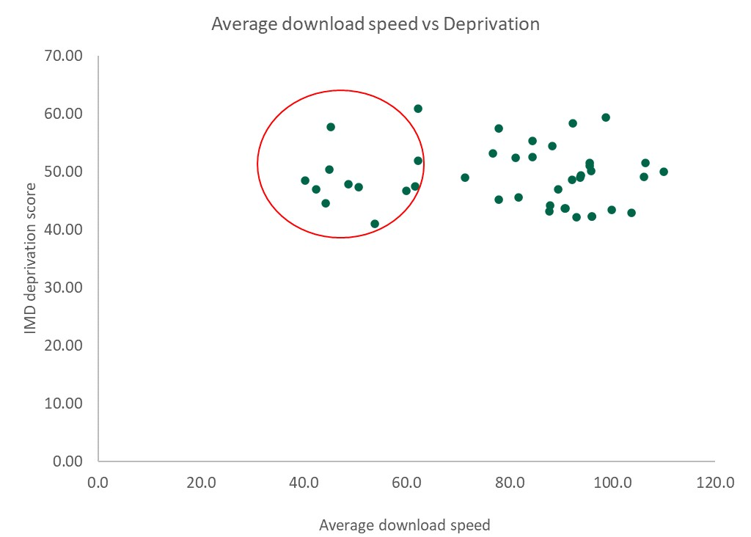
Deprivation
vs Digital
Access by
Ward Graph
This chart compares
population
-
weighted IMD
MSOA score to MSOA
average download speeds.
This data includes
the most
deprived MSOA areas across
the ICB, which is determined
by an IMD score above 40
.
A sub
•
-
set of wards with
high deprivation and low
The wards in the red circle include (lower average download speed, high IMD score):
download speed is seen in
Shiregreen
North (40.2, 48.57)
Woodhouse West (53.7, 41.07)
the top left of the chart.
•
•
These wards also tend to
•
Stainforth (42.4, 46.96)
•
Tinsley & Carbrook (59.9, 46.74)
have lower median aged
•
Maltby East (44.3, 44.57)
•
Shiregreen South (61.7, 47.49)
population.
•
Thrybergh & Hooton Roberts (45.0, 50.47)
Herdings & Gleadless Valley (62.3, 51.91)
•
•
Batemoor & Jordanthorpe (45.2, 57.80)
•
Thurnscoe (48.6, 47.92)
Higher IMD score = most deprived
•
Goldthorpe (50.7, 47.39)

Slide 8
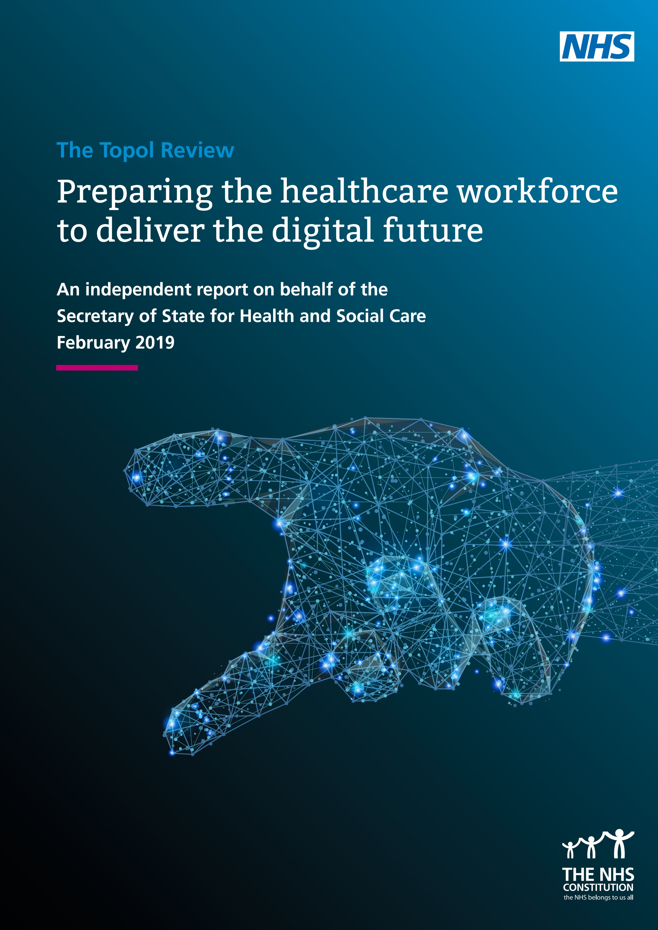

Slide 9
DATA TRANSLATION

Slide 12
THE LANGUAGE BARRIER
PATIENT PATHWAY VERSUS THE DIGITAL PATHWAY
TRANSLATION
CLINICAL SAFETY

