Slide 1
Northern, Yorkshire and Humberside
Directors of Informatics Forum (NYHDIF)
Annual Conference
November 2022
A supplier perspective: Looking after our Own
Declan Hadley
Cisco Healthcare Lead UK&I

Slide 2
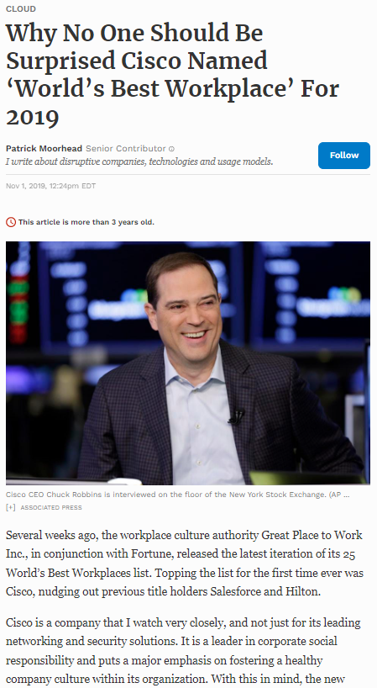
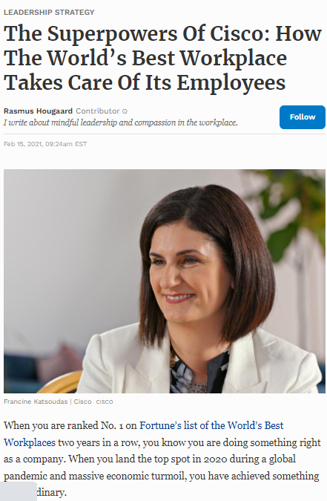
A great
place
to work

Slide 3
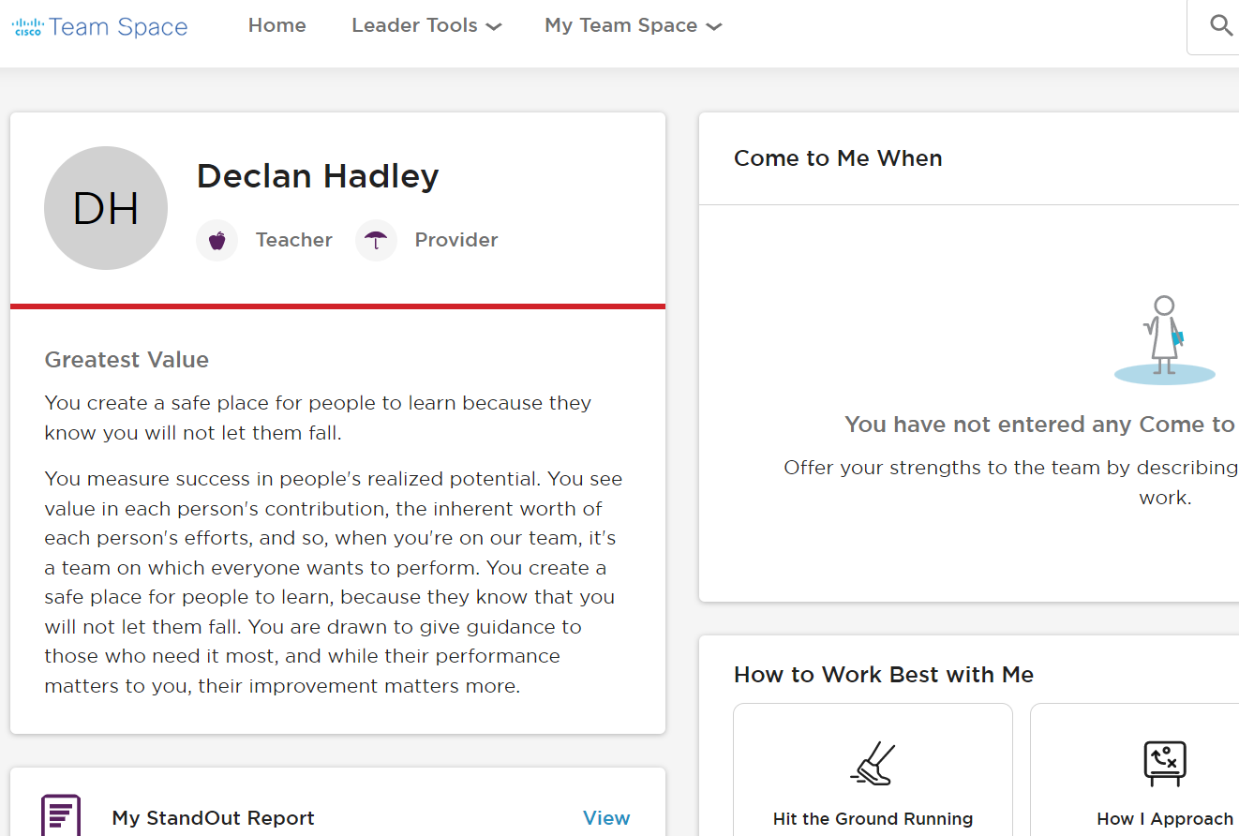
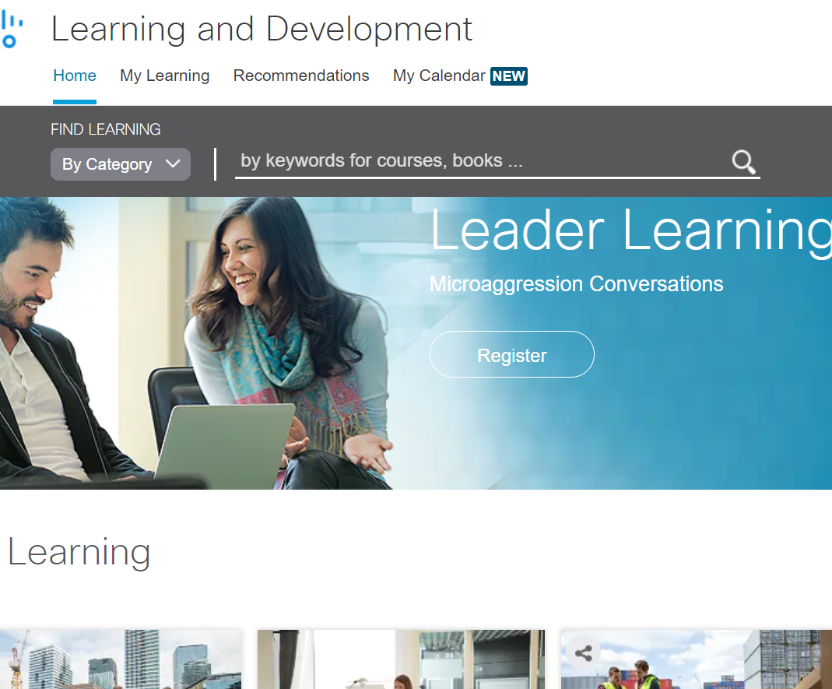
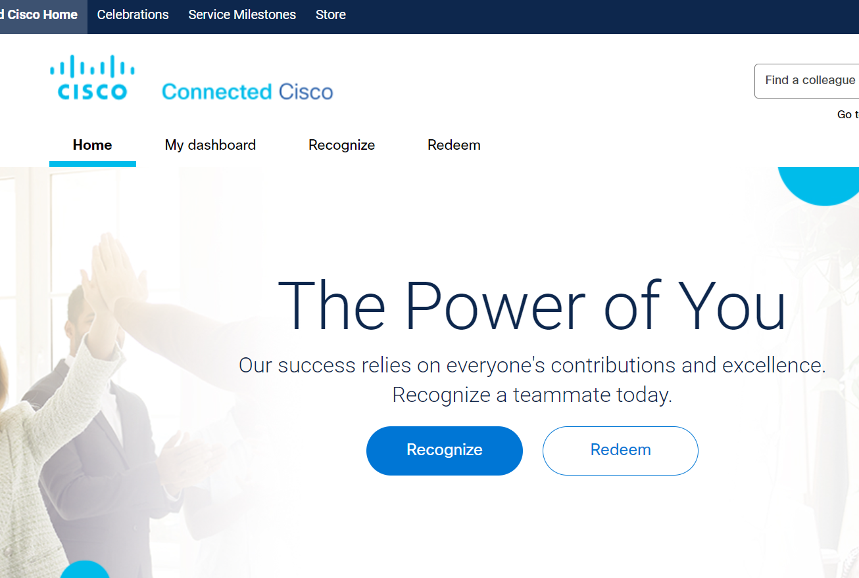

Slide 5
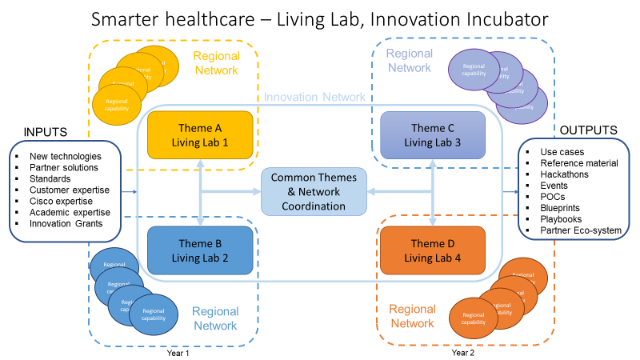
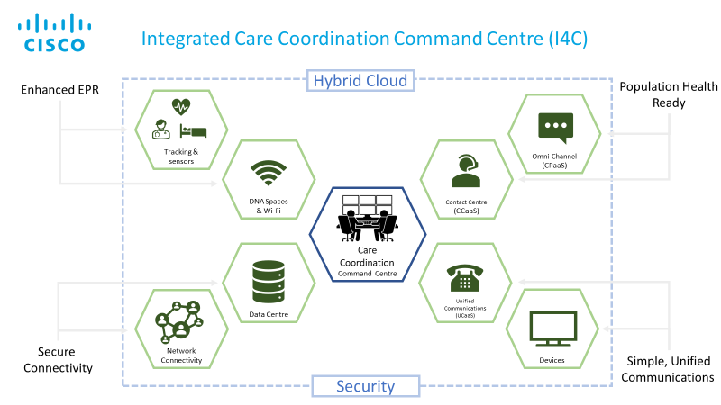
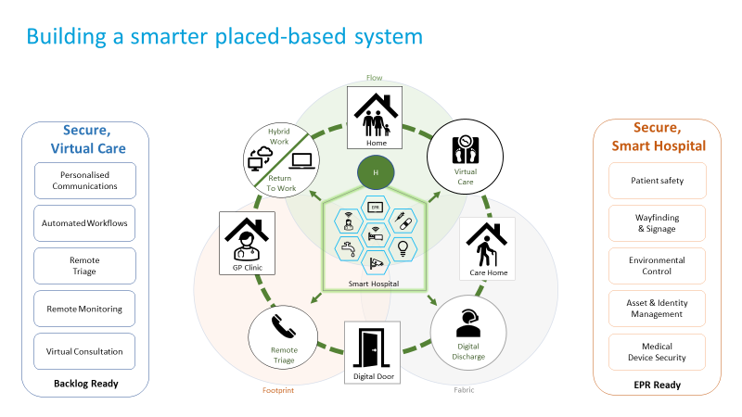
Freedom to act
Common Purpose

Slide 6
Easy to Innovate - Smarter healthcare – Living Lab, Innovation Incubator
Regional capability
Regional
Network
Regional
Network
Regional capability
Regional capability
Regional capability
Regional capability
Regional capability
Regional capability
Innovation Network
Regional capability
Theme A
Living Lab 1
Theme C
Living Lab 3
INPUTS
OUTPUTS
New technologies
Partner solutions
Standards
Customer expertise
Cisco expertise
Academic expertise
Innovation Grants
Use cases
Reference material
Hackathons
Events
POCs
Blueprints
Playbooks
Partner Eco-system
Common Themes & Network Coordination
Theme B
Living Lab 2
Theme D
Living Lab 4
Regional capability
Regional capability
Regional capability
Regional capability
Regional capability
Regional capability
Regional capability
Regional
Network
Regional capability
Regional
Network
Year 1
Year 2

Slide 7
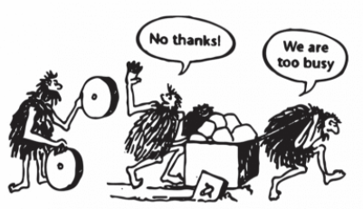
Looking after our Own?
Conscious culture
Hybrid working down to a fine art
Team get togethers / check-ins
Simple to recognise & reward
Technology that just works
Autonomy by default
Easy to switch off
Not a lot of email
Career progression

