Slide 1
Digital Leaders: Our Time is Now Presentation for Northern and Yorkshire Directors of Informatics Forum
19th Nov 2022
@pipgoff pip.goff@forumcentral.org.uk
Notes:
Is this 'our time' as Digital leaders?
Is it different from previous periods of opportunity?
What are the expectations being placed on Digital?
Are the expectations realistic?
Are we suitably placed to really make change happen?
Who do we need to engage and collaborate with?
Digital Leaders: are you making time for the third sector?
What is the 3rd, VCS sector? - Sots & Durham research - incl, links
- What major role are you contributing towards holistic care? - NHS 3 outcomes, PHM, HIs, person centres – King’s Fund wider determinants of Health
- How are you being linked in to ICB strategies (local and regional)?
- Why do your services need to be built into all aspects of digital planning? - – slide from workshop
- What does the sector look like now in terms of digital skills and kit? -
- What key messages would you like Digital Leaders to take away? - digital and data underpin effective ICB – if you’re interested in driving PH outcomes, using TS assets, understanding PH, allocating resources effectively, getting best value, tackling HIs, being patient/person centred …then you can’t afford not to involve the TS

Slide 2
‘Digital and data underpin effective health and care system working. If we are interested in driving Public Health outcomes, understanding our communities, allocating resources effectively, getting best value, tackling Health Inequalities and being patient/person centred …then we can’t afford not to involve the voluntary, community and social enterprise sectors’.
Cathy Elliott, Chair of NHS West Yorkshire ICB

Slide 3
Voluntary, Community and Social Care Enterprise (VCSE)/ Third Sector
Critical partners within our health and care system
Improving the health and wellbeing of communities
Access to services for people with complex needs and marginalised communities facing greatest inequalities.
Join uphealth, social care and housing - integration and coordination across boundaries.
COVID-19 and Cost of Living emergencies responding rapidly and flexibly COVID-19 and Cost of Living emergencies
Notes:
Direction of travel - increasingly collaborative work across third sector and city partners
Covid - radical shift accelerated digital transition but widened divide with excluded communities; Leeds Shielding; Community Care hubs→ LLC Welfare and current context of the Neighbourhood and Communities Review; Covid-related expanded engagement with Public Health - all leading to a greater role of digital in service planning, delivery and as part of shift to more collaborative approach to working
Significant spotlight on system pressures: discharge - hospital/LCH Neighbourhood teams
Build on LCC good practice; Children’s Services Adult Social care - SWiFt workers; Better Lives Board; Listening Project
Integrated Digital Services: city focus on investment planning in digital
Fast pace of change in health – e.g. Population health data, service re-design, provider sharing eg Social Prescribing; Community MH teams; Leeds Mental wellbeing service etc; new challenges - transformation and Crisis; Shared Care Record, patient booking, digitisation, cyber security
Information Governance, cyber security

Slide 4
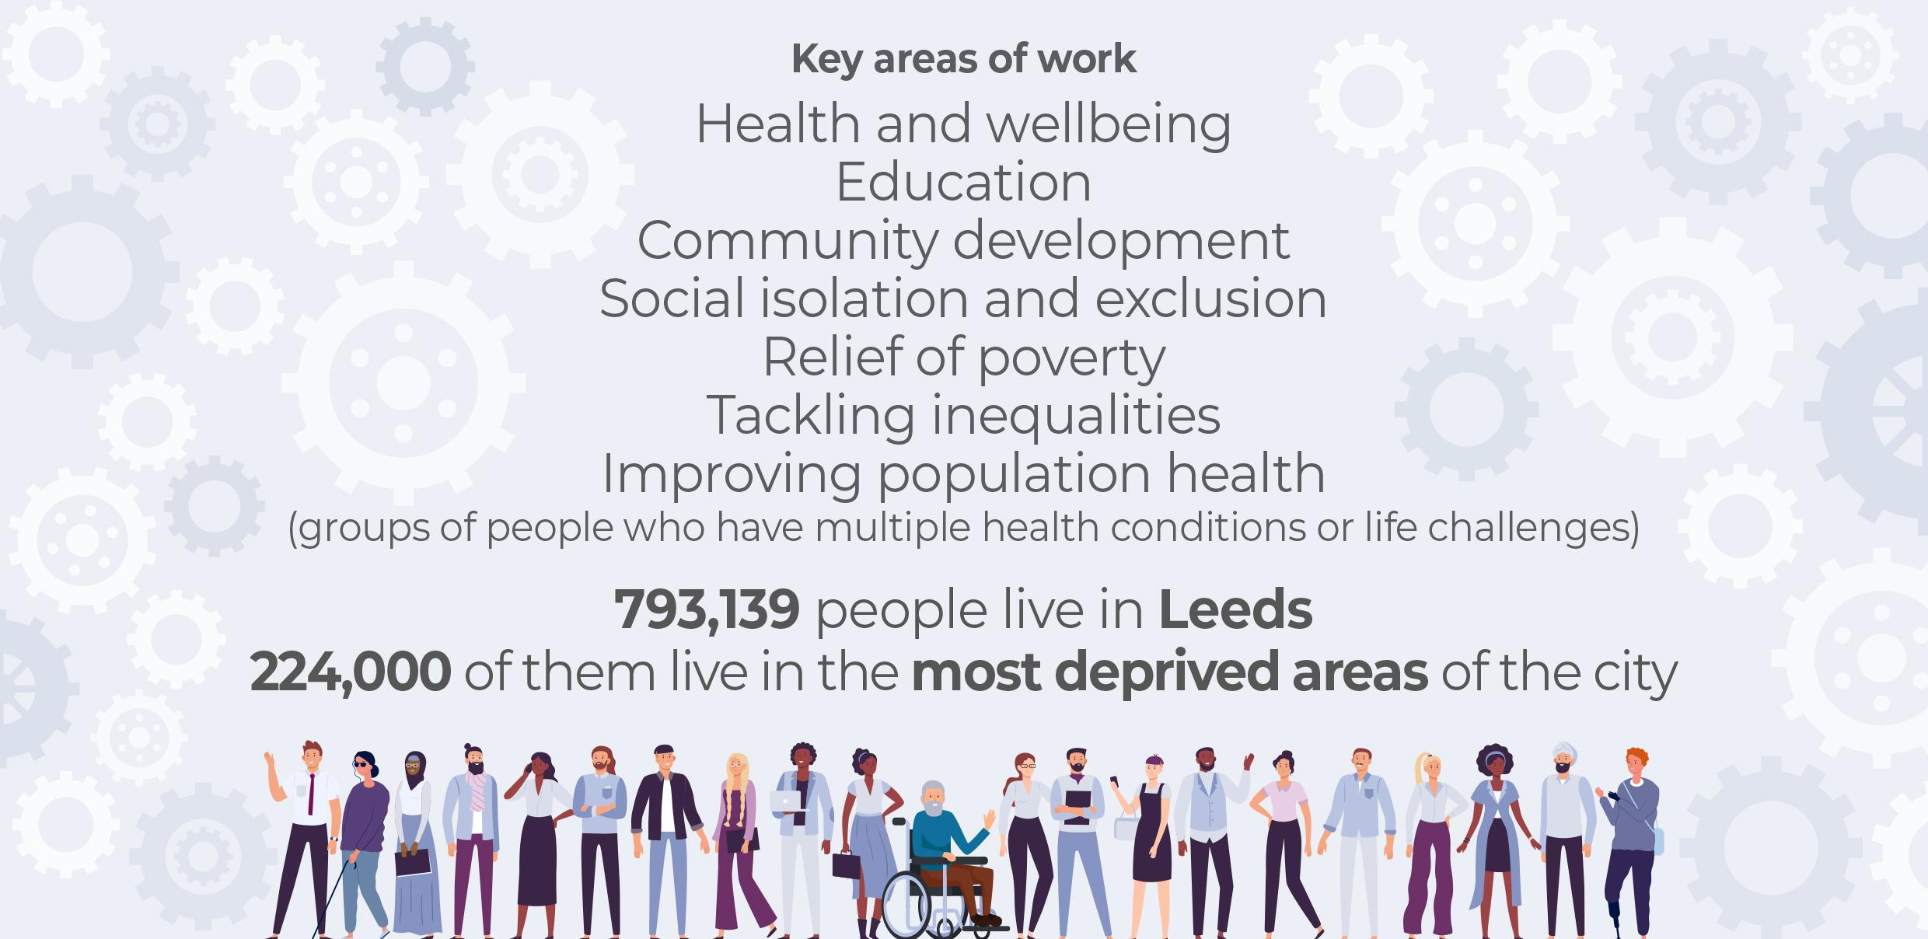
Notes:
These key areas of work speak for themselves in terms of their impact on health and wellbeing
• poverty,
• inequality,
• mental health,
• physical and learning disabilities,
• social isolation and exclusion, and,
• Population Health Management.
In Leeds, multiple inequalities known to be significant for health and wellbeing exist...this is why improving population health is such an important area of work
It’s also precisely the reason why the role of Third Sector Organisations that provide ongoing, long-term support to people with complex needs to so crucial
We thought it was useful to show this in terms of the Leeds population
The total population of Leeds is 793,139.
Of this:
An estimated 224,000 people (28% - just over a quarter) live in the most deprived 10% of areas, with almost 80% living in seven of the Local Care Partnerships (Harehills, Chapeltown, Middleton, Burmantofts and Richmond Hill, Beeston, Seacroft, and Armley).
Those areas are generally well-served by Third Sector Organisations rooted in local communities

Slide 5
Life course: sectors that community organisations work in and their beneficiaries
Health equity across life course
Children, young people, & families
Adulthood
Birth, neonatal, infancy, early years
Childhood & adolescence
Older adulthood
203 benefit people from diverse ethnicities
929 VCSOs benefit children and young people
667 benefit the general public
483 benefit older people
485 benefit people with disabilities
Notes:
Can seem complex but Digital is a crucial part of providing an interface and access for system partners

Slide 6
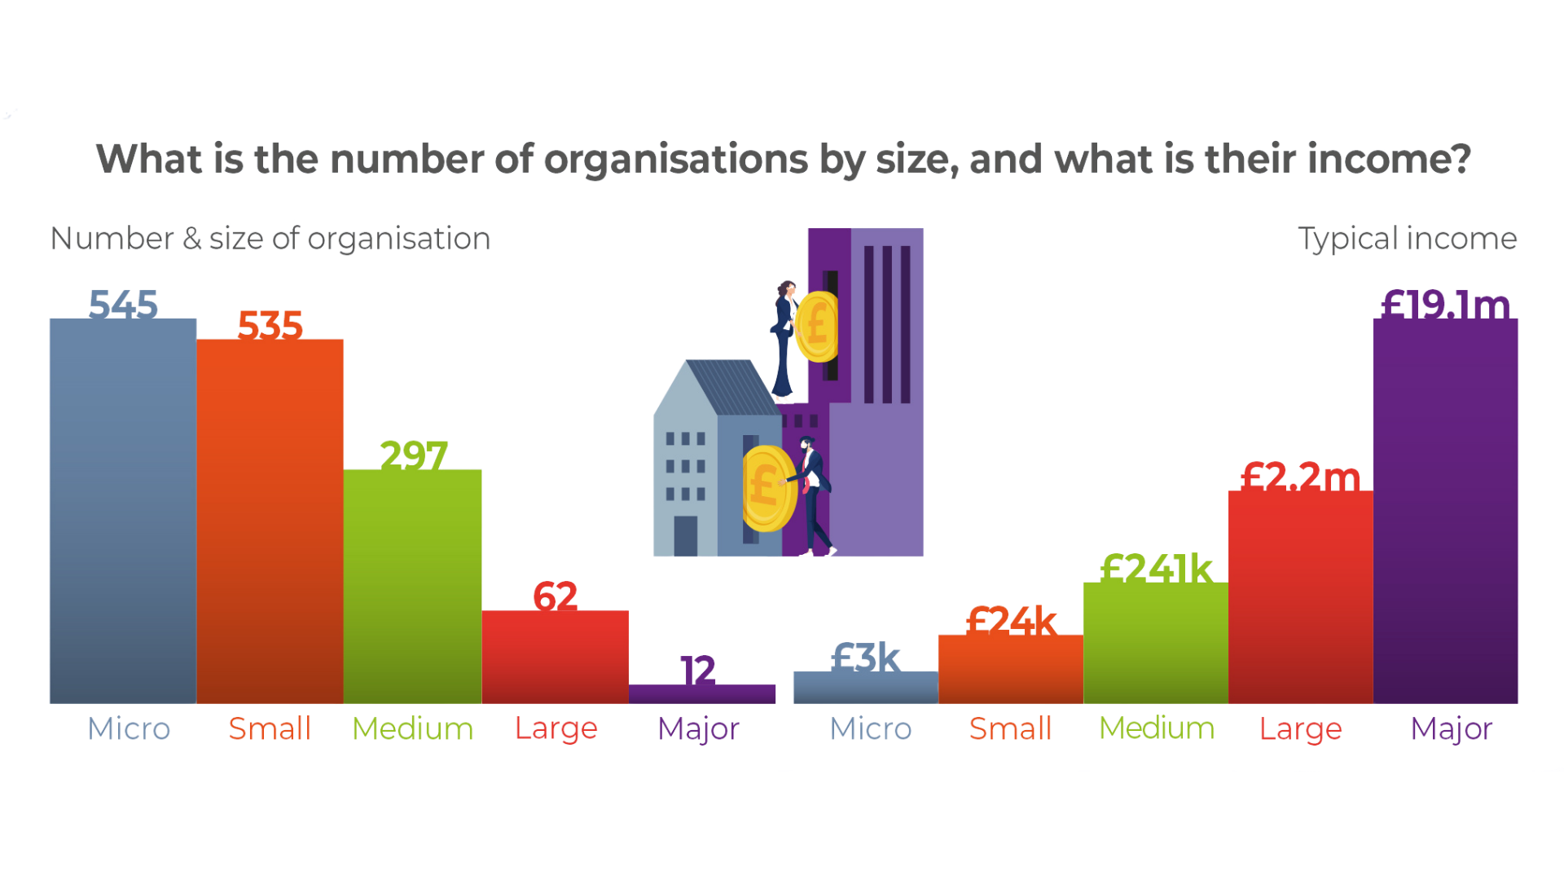
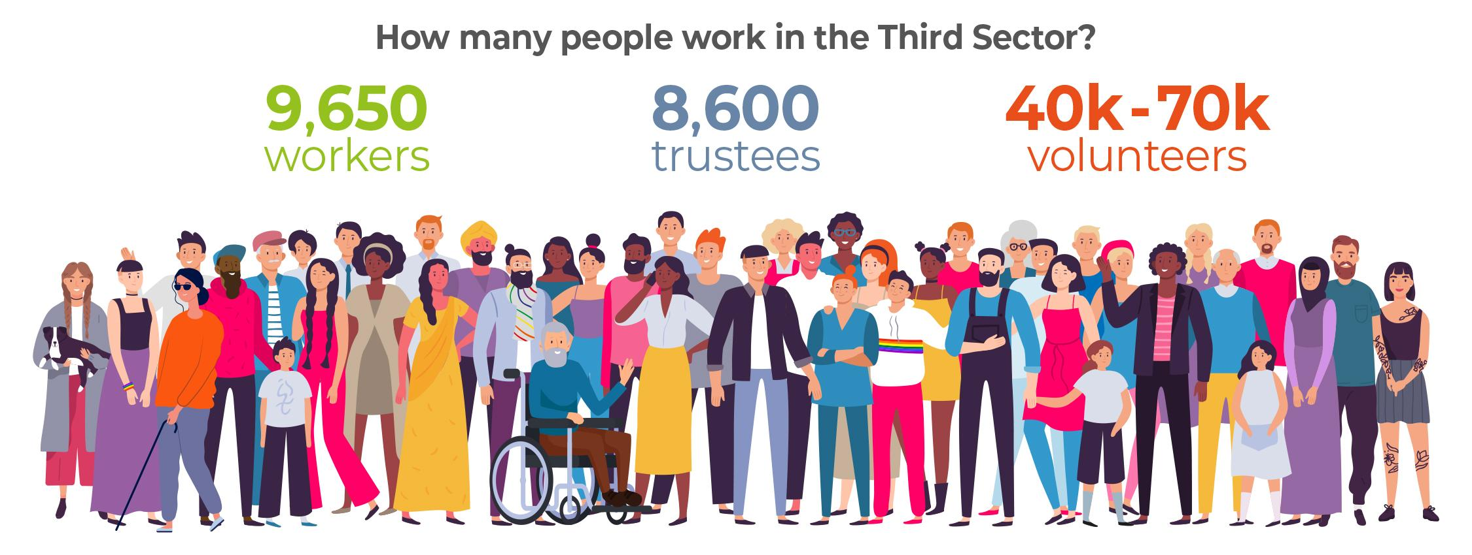
Notes:
Leeds headline findings (much more detail in the full report)
Firstly, How many organisations are there?
There are two main types:
One type is: Informal, emerging and un-constituted
These organisations are well connected to their communities, increasing opportunities for inclusion of diverse voices.
The other type is: registered charities
Our research estimates
2,000 informal and
1,533 registered organisations
Which we’ve rounded up to 3,500
We can only report with confidence on the registered charities, because of the information they provide annually to the Charity Commission, so this research can’t include information on the staff, services and impact of the 2,000 informal orgs

Slide 7
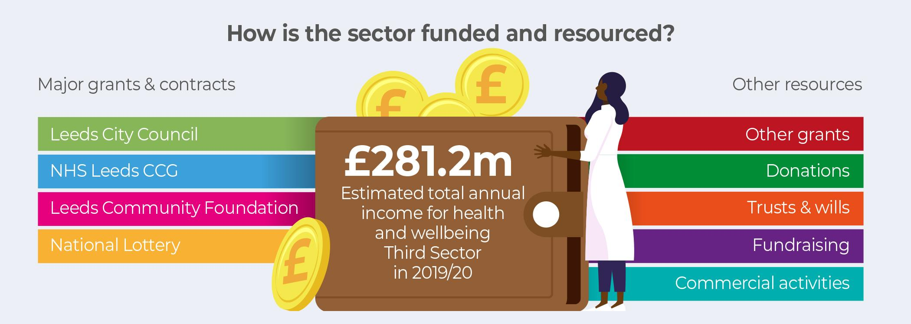
Notes:
How these organisations are funded and resourced was one of the most challenging aspects of the research
This has been conservatively calculated
We’ve excluded some for the purpose of producing a more representative picture
We felt that if we included registered charities like The Grammar School at Leeds, Yorkshire Cancer Research Leeds, Trinity University and the Leeds Grand Theatre & Opera House - this would distort the picture
Lhasa Limited
Leeds Diocesan Trust
Yorkshire Cancer Research
The Free Grammar School of King Charles II
Leeds Grand Theatre and Opera House Limited
The Wilf Ward Family Trust
Leeds Diocesan Board of Finance
The Grammar School at Leeds
Leeds Trinity University
The major grant and contract organisations listed here all report on Third Sector funding differently, so - again - this is a very conservative calculation
Most grants are small and short term.
Around a third of registered TSOs also generate additional income through fundraising and commercial activities including wills, gifts and donations, space hire, sale of products, and services. These funds are typically used to pay for core functions.
The funding (and wider financial situation) for many small and grassroots TSOs is precarious leaving them vulnerable to shocks and uncertainty about their sustainability.
And - of course - income generating activities have been significantly affected by COVID-19, with organisations having to
adapt their services and often seeing much higher levels of demand

Slide 8
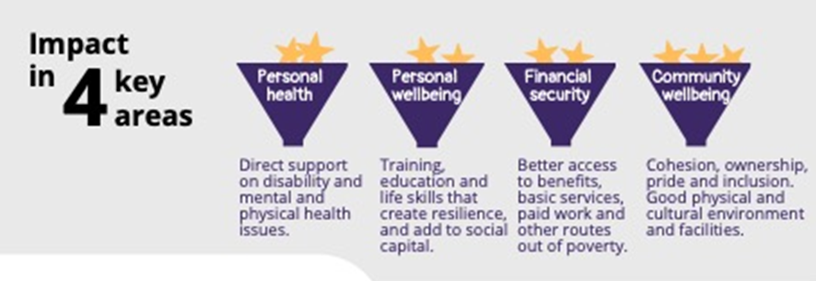
Presentation2.pptx (live.com)
WY Presentation
Full WY research report
Notes:
Durham University research ( West Yorkshire and Harrogate Health and Care Partnership (WY&H HCP) and Humber, Coast and Vale Health and Care Partnership, West Yorkshire Combined Authority, Yorkshire Sport Foundation, and Community First Yorkshire commissioned; led by Professor Tony Chapman) on the structure, dynamics, and impact of the Voluntary, Community and Social Enterprise (VCSE) sector, including across the WYH geographic area.
https://www.wypartnership.co.uk/our-priorities/harnessing-power-communities/research-and-reports

Slide 9
National Focus
The enabling role of digital spans across all of this work - How do we make sure this includes the third sector?
NHS Long Term Plan and NHS Five Year Forward View Partnership working between the Third Sector, Local Gov
and the NHS is crucial to improving care for people and communities.
The NHS Long Term Plan and NHS Five Year Forward View highlighted the need for closer working across these sectors to address the wider determinants of health.
Marmot post covid and increasing Health Inequalities
Shift in focus and funding from acute services to prevention and better meeting people’s physical, mental and emotional health and well-being health and care needs in the community
Notes:
Can you make a connection with the digital world here - i.e. Digital is part of how we work, how we live and therefore needs to be integrated into how we work as a system
- the ‘left shift’
The visibility of charities and voluntary organisations throughout the NHS Long Term Plan is really encouraging and provides a strong baseline for accountability of national and local health bodies in years to come.
On a national level, there is a commitment to voluntary sector membership in the new NHS Assembly.
Throughout the 136-page document, the voluntary sector is regularly highlighted as part of what will build the future of the health service.

Slide 10
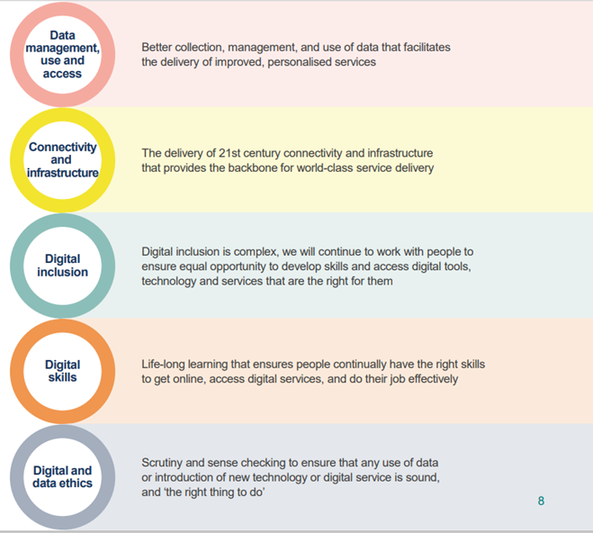
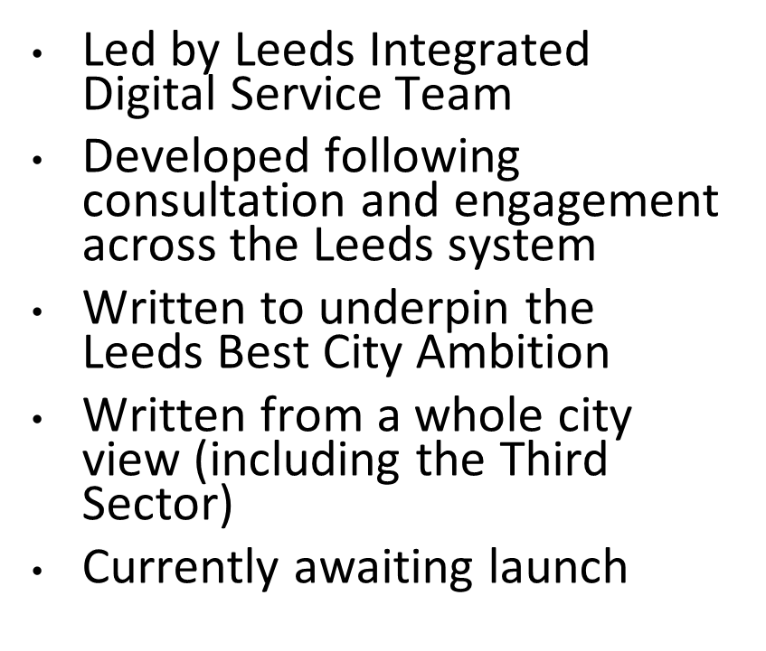
Notes:
The third sector has been involved in developing the strategy
As an equal partner of the Leeds Health & Care Partnership, we’re committed to getting the building blocks right

Slide 11
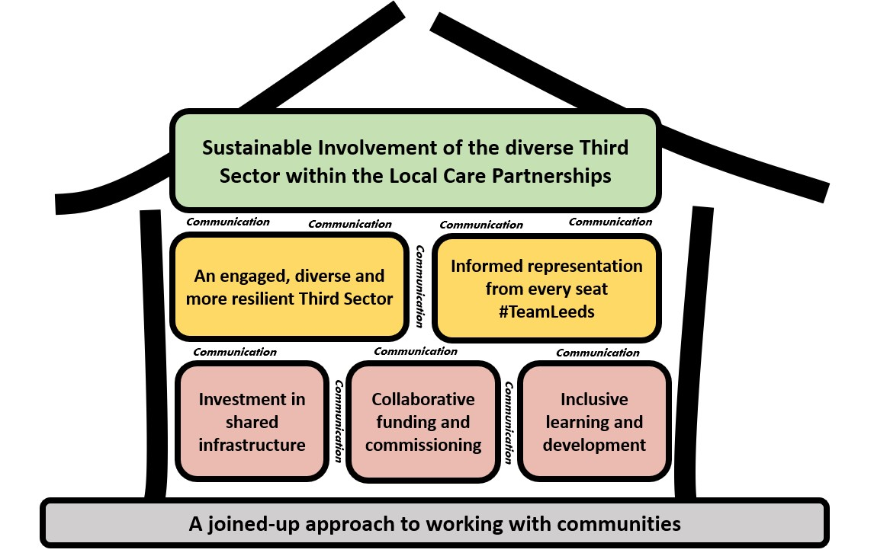
Embedded across all parts of the system
Forum Central staff and/or third sectors reps are involved at all levels of the Leeds and W Yorkshire ICB.
The Leeds Health & Care Partnership is working hard to support third sector integration through collaborative working on:
Population Health Management
Governance
Workforce
Estates
Digital
Notes:
Caldicott requirement

Slide 12
How this fits with the city plan
LCC
NHS including CCG WY ICS
Inclusive Growth
Health & Wellbeing
Third Sector
Climate Action
City Partners
City Strategies
Integrated Digital Service (IDS) Digital Strategy: to enable the city strategies by partners, and drive better outcomes for people in Leeds
Regional
Place
Neighbourhood
Notes:
A reminder that our focus is on what the third sector needs, and how to deliver on this through policy, strategies, plans and investment opportunities offered through the City Plans, the new Digital Strategy to enable those plans, and also through the assets, resources and investments that third sector organisations leverage into Leeds.

Slide 13
Working together to support third sector needs
Translation of core activities
Digital integration
Third Sector digital enablement
Data sharing
Digital inclusion/capability
City Digital Strategy & investment to enable City Plans
Investment & resources attracted by the Third Sector
Notes:
Not time today but ref Mindwell; Pyramid of Arts
Provision and Translation of Core Activities: Continue to support third sector organisations to translate current and future activities to digital/hybrid platforms in line with the needs of communities served; through investment in inclusive infrastructure, roles, and training.
Digital Integration: Improve access to, and quality of, information about third sector provision for system partners and citizens through investment in shared digital information infrastructure.
Data Sharing: Enable relevant third sector organisations to access and share information about citizens of Leeds, in support of joined up, person-centred delivery; through investment in shared information governance roles.
Digital Inclusion: Continue to extend the role that the third sector plays in providing personalised support to the people in Leeds who are most vulnerable to digital exclusion, through work with 100% Digital Leeds.

Slide 14
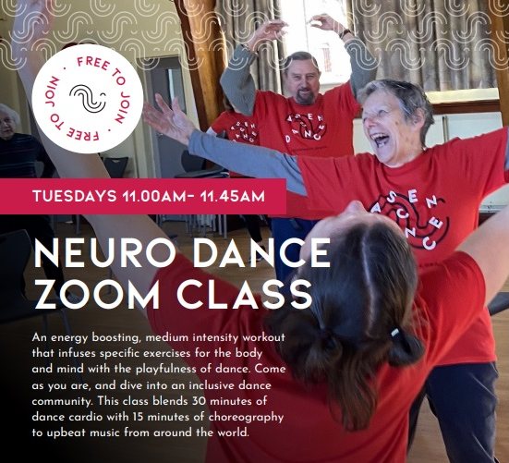
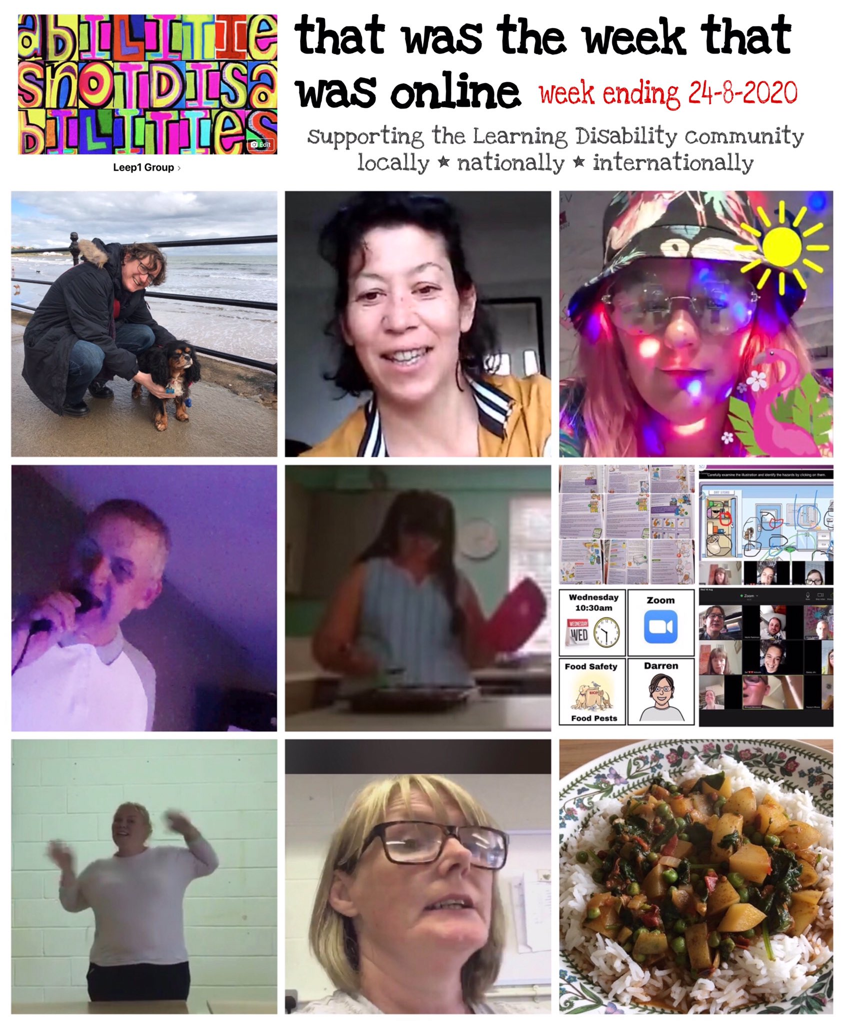
Digital Delivery ALLaDDIN
Body of the text
Notes:
Leeds TS identified 4 key areas for improvement:
Priority 1 Digital Delivery
Provision and Translation of Core Activities: Continue to support third sector organisations to translate current and future activities to digital/hybrid platforms in line with the needs of communities served; through investment in inclusive infrastructure, roles, and training.
Across the course of the pandemic, there was a rapid translation of core activities within the sector to online and hybrid ways of working. This included:
Swift mobilization of digital communications, making sure organisations maintained existing relationships with people accessing their support, and continuing to reach out to target groups.
Delivery of social and therapeutic activities online
And Development of creative digital media outputs
Here in this slide we have Ascendance’s neuro dance classes and a post from Cafe Leep showcasing some of the work they did over the pandemic - These illustrate just how adaptable the Third Sector has been in translating a range of activities to online formats and supporting different communities to engage.
But there are signficant challenges in sustaining this work moving forward -
Challenges:
How do we balance peoples needs/preferences around digital access and face to face contact moving forward?
How do we support continued development of our work online as well as off line when capacity is low?
How do we ensure our workforce have the skills and resources to deliver online and off line ,within current contracting arrangements
In order to meet the challenge - We believe the third sector could provide services and support more effectively, if there was additional investment in:
▪ Support for training existing colleagues and volunteers
▪ Enabling access to digital development expertise
▪ Building better hardware and software systems to give parity to the sector

Slide 15
Digital Integration
Body of the text
Enabling better:
collaboration
signposting/referral
use of funds
offer to people
Notes:
Priority 2: Priority 2: Digital Integration
Digital integration is about the digital infrastructure to enable the Third Sector, system partners and communities to work better together -
Opportunities: Strategically, we have seen a drive to integrate the third sector into a broader Leeds offer with the investment in Local Care Partnerships and Leeds Health and Care Partnership structures.
But, It’s nowhere near as easy as it should be to find out what the third sector does in different localities and with different communities across the city to support this work - As a sector we are constantly trying to map out our assets in different parts of the system, for funders and commissioners, practitioners and to aid our own understanding - At the moment in Leeds there’s no single place to hold the information and no established process or resourcing to ensure information about Third Sector provision is kept up to date and consistent across outputs.
This gap in provison has an impact on the reach of our support within communities, making it hard for practitioners to refer and signpost people to support. but it also makes it difficult to identify where the gaps are in provision, to inform policy making, commissioning and funding of services in the future - And ultimately, build upon our strengths and tackle inequalities
There has been some positive work conducted in the city around this priority, most notably the LOOP project, but unfortunately we don’t currently have a funded long term solution which meets all our needs.
We believe We need the tools to improve access to, and quality of information about third sector provision for system partners and citizens through commitment to and investment in a shared digital information infrastructure, which can be promoted to professionals and the public - tools that bring greater visibility of the Third Sector for people and system partners
From a citizens perspective, it can be hard to find out what support is available to you,
From a practitioners perspective it can be difficult to signpost and refer to community based services, with confidence that the provision is what the person needs
From a policy maker, funder and commissioners perspective there is no established way of finding out what is already being delivered in communities, where funding is being used and where the gaps are – How therefore are we enabled to work in a joined up way.

Slide 16
Data Sharing
“The less I have to repeat myself to professionals when I am unwell the better – I’d like the info to be shared to help people talk to me better and create an accurate picture of my mental health needs too.” Mental health services in Leeds
Notes:
Priority 3: Data Sharing
What are we talking about?
Enable relevant third sector organisations to access and share information about citizens of Leeds, in support of joined up, person-centred delivery.
Often the third sector is a recipient of referrals from public sector organisations, because it is able to tailor and target its offer to people’s life experience. However, third sector organisations rarely have access to essential information systems and data that are routinely available to public sector partners.
The impact of this disjoin poses significant risks and challenges to achieving citywide objectives laid out in the City Ambition and the Healthy Leeds Plan, but also more practically reduces the efficiency of all service providers, and crucially resulting in fragmented provision for citizens.
We need to stop talking about data in isolation of people – Data is often captured because people have trusted us to provide them with the support they need. If we are to make the most of the assets in the Third Sector we need to learn how to share data with other parts of the system
We believe that our city can improve the sharing of information by:
▪ Identifying key data systems that need to be shared and enabling the participation of the third sector in them; for instance, by building on pilot work to extend the Leeds Care Record into the third sector.
▪ Identifying and addressing challenges experienced by the sector, such as demonstrating information governance compliance, and completion of the Data Security Protection Toolkit, that limits the third sector’s access to information systems

Slide 17
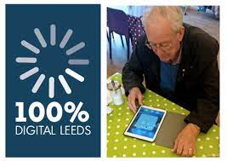
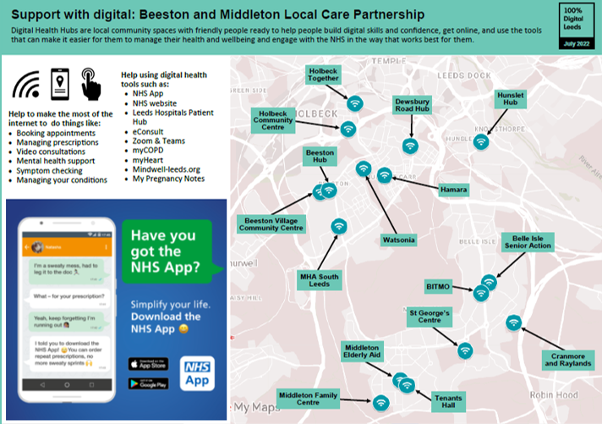
Digital Inclusion
Body of the text
Notes:
Priority 4: Continue to extend the role that the third sector plays in providing personalised support to the people in Leeds who are most vulnerable to digital exclusion
The third sector plays an important ‘bridging’ role to communities, providing a key means of upskilling digitally excluded citizens and promoting the use of digital services. During the pandemic the third sector has worked closely with the 100% Digital Leeds team, on a range of programmes and activities including the development of specialist Digital Inclusion networks and the piloting of the Digital Health Hub Model.
There are significant opportunities through prioritisation of this work.
Unlocks barriers to support for people
Enables people to make more informed decisions about their health and care
Enables people to be more actively involved in management of their own health
Provides people with greater choice of support
We believe that further investment in digital inclusion is needed, and we welcome the opportunity to explore how 100% Digital and third sector infrastructure organisations working together, might establish partnerships that can attract further investment of tailored programmes aiming to address digital exclusion within some of our least served communities.

Slide 18
Third Sector digital work examples
Digital Enablement of the Third Sector in Leeds -progress and the case for supporting digital enablement
Community and Third Sector Digital Transformation - VAL with Forum Central: key areas for development
Third Sector Visibility Project - building on LOOP
Digitising-Leeds-Risks-and-Opportunities
Notes:
We have been collectively thinking and working on this, and trying to approach it from different angles with partners
This is an update of a paper shared with Alastair Cartwright, LCH and The team leading the WY digital strategy (Pip shared it with Leonardo and Tim Ryley) from May 21
Work led by Volition - That May paper was also shared with Health and Care Leaders too.

Slide 19
Barriers to integration:
It is hard to navigate services
knowing who does what, who to contact and how to access services.
Where the third sector can access NHS patient information systems:
creating a barrier to providing seamless, joined up care.
Challenges to meet NHS governance, contractual and reporting requirements and meetings convened by statutory agencies can be intimidating & / or inaccessible:
due to limited central / corporate resource other than in the largest 3rd sector organisations, and the formality and scale of statutory agency’s meetings.
Insecurity of third sector funding:
short term and not supporting full cost recovery, resulting in organisational financial insecurity and risk of losing staff with significant skills, knowledge and expertise from the Leeds health and care system
Notes:
The visibility of charities and voluntary organisations throughout the NHS Long Term Plan is really encouraging and provides a strong baseline for accountability of national and local health bodies in years to come.
On a national level, there is a commitment to voluntary sector membership in the new NHS Assembly.
Throughout the 136-page document, the voluntary sector is regularly highlighted as part of what will build the future of the health service.

Slide 20
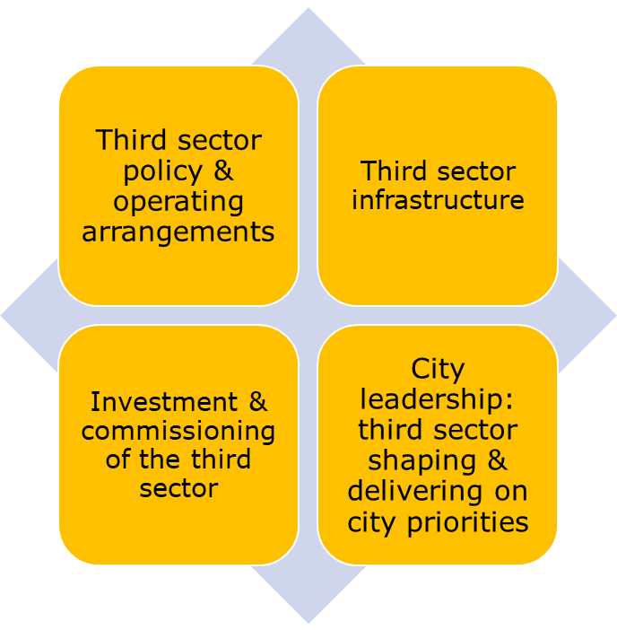
Questions for you
How can we work together to ensure the third sector is where it needs to be to co-produce strategy and plans, and secure investment so the third sector is properly resourced to play its part?
What do we need to do to articulate our collective ambition, priorities and recommendations, which feed into all our strategies & plans?
How can you support third sector colleagues to connect with the strategic development?
How much resource can we leverage from across the system to provide capacity to make this happen?
Notes:
Back to your own teams to think about:

Slide 21
